Slide 1
I Want To Become A Teacher
Made by D. Smirnov
English teacher I.V.Votinova

Slide 2
MY DREAM
From the very childhood I dreamt of becoming a teacher. Now, when I’m a high school student, I often think over my choice.

Slide 3
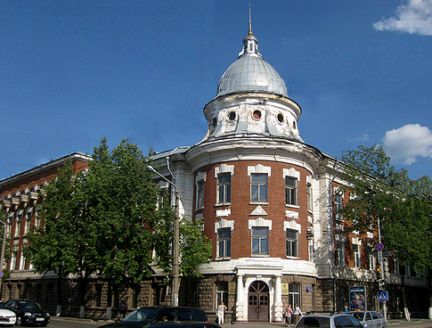
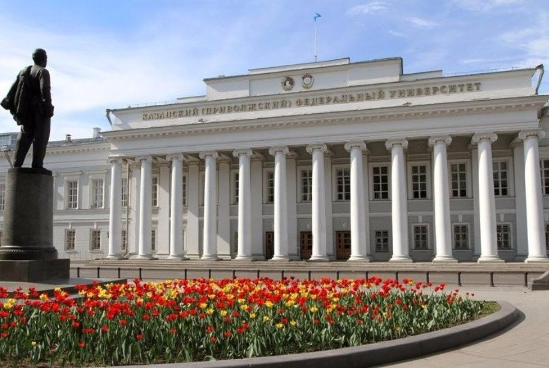
I don't know exactly where to go after graduation. The universities that I chose have a history Department where I can study to become a history teacher.
I want to go to Kazan Federal University and Perm state humanitarian-pedagogical University

Slide 4
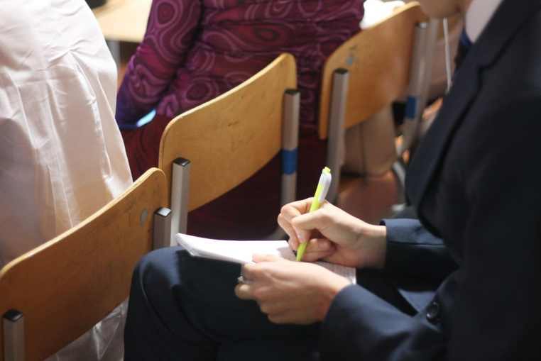
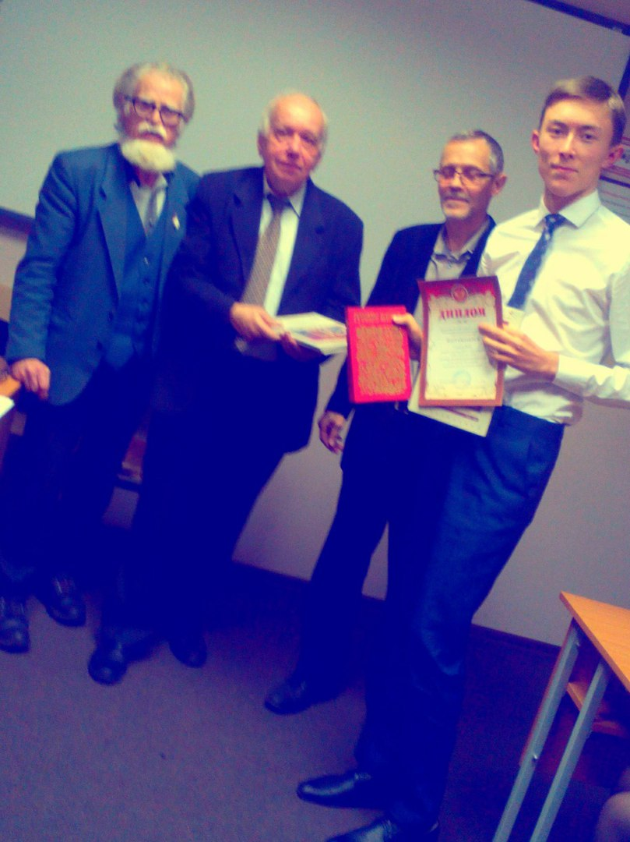
I've always loved to read, especially the history of Russia. At University I hope to develop and expand their knowledge.

Slide 5
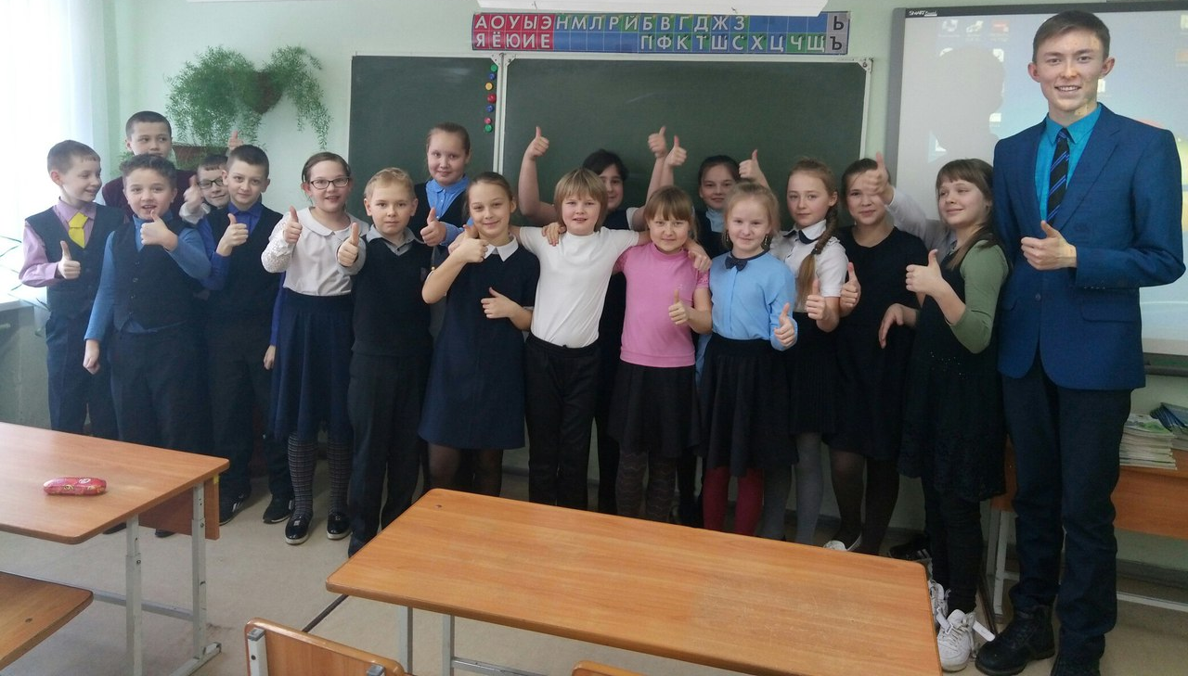
When I become a teacher, I am ready to share that knowledge and love of history among the younger generation.

Slide 6
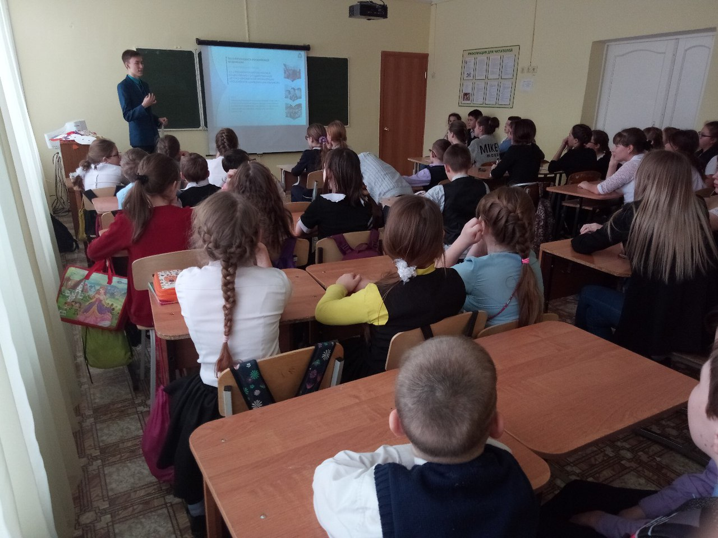
In my opinion, every good teacher teaches his students not only one object but different life lessons. If I can help them learn the basics of survival in this life, I will gladly do it.

Slide 7
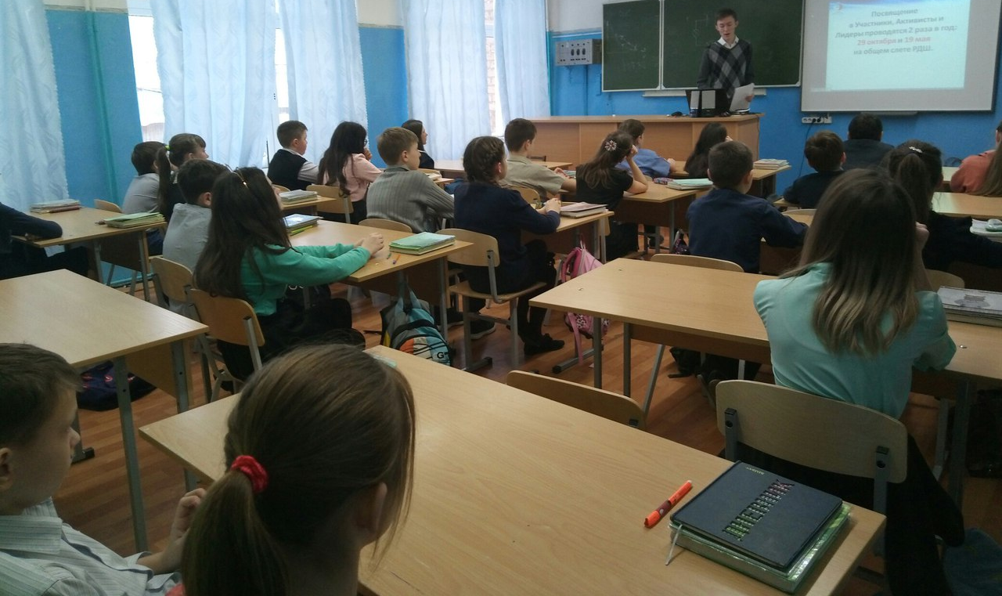
I understand that keeping the attention of twenty-five and more children during several lessons requires lots of energy, enthusiasm and dedication.

Slide 8
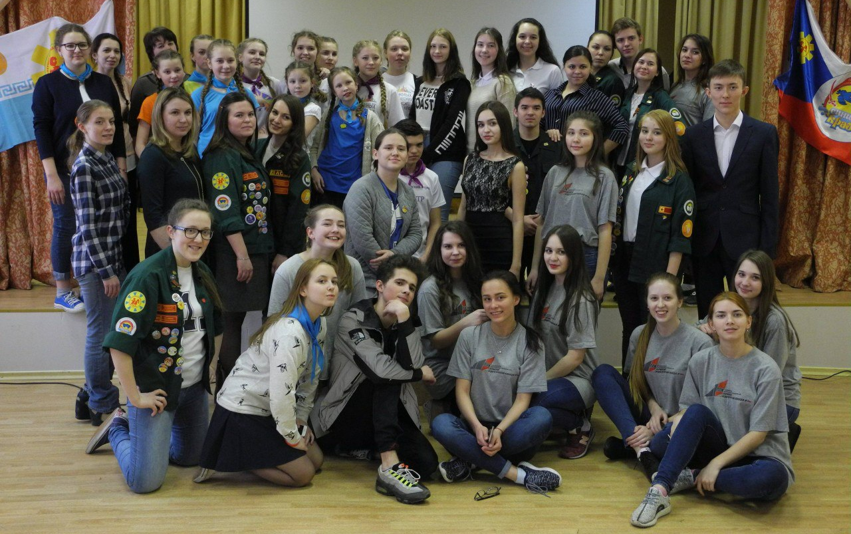
I also understand that this profession doesn’t pay well and isn’t very prestigious nowadays. Nevertheless, when you love your job, it gives you lots of positive emotions. Being a teacher can be very rewarding.

Slide 9
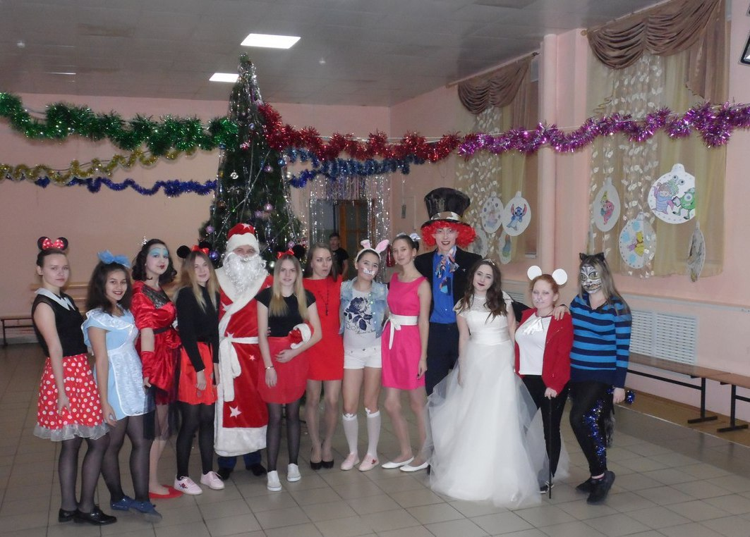
A good teacher must possess many qualities: to be creative, hard -working, self-restrained, able to solve problems and make the right decisions.

Slide 10
I know that some prestigious and highly paid professions can become a heavy burden for many young people. Moreover, opting for the most common and not fashionable jobs, you can achieve very good results and get real satisfaction, and sometimes the purpose of your life. I hope that I will succeed and I will never be disappointed about my choice.

Slide 11
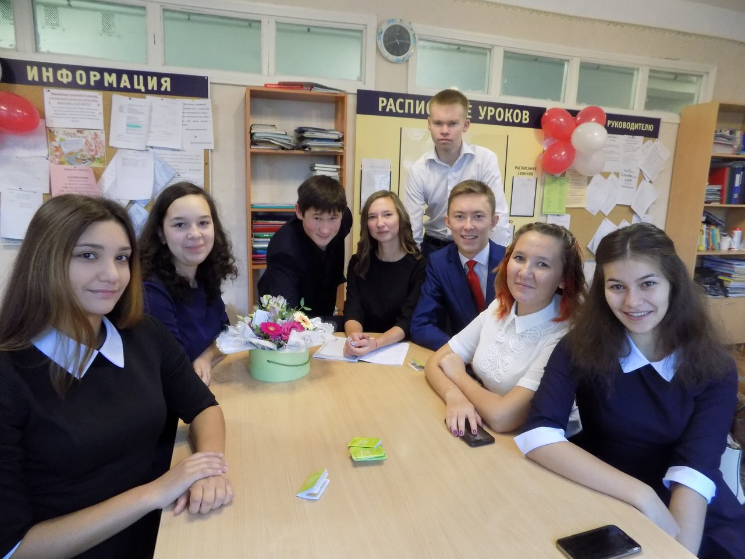
Teachers do not only teach their subjects. They develop their pupils’ intellect, their attitudes to life and to other people

