Slide 1
My plans for the future Interior designer
Author Liza Supolova
Head I.V. Votinova

Slide 2
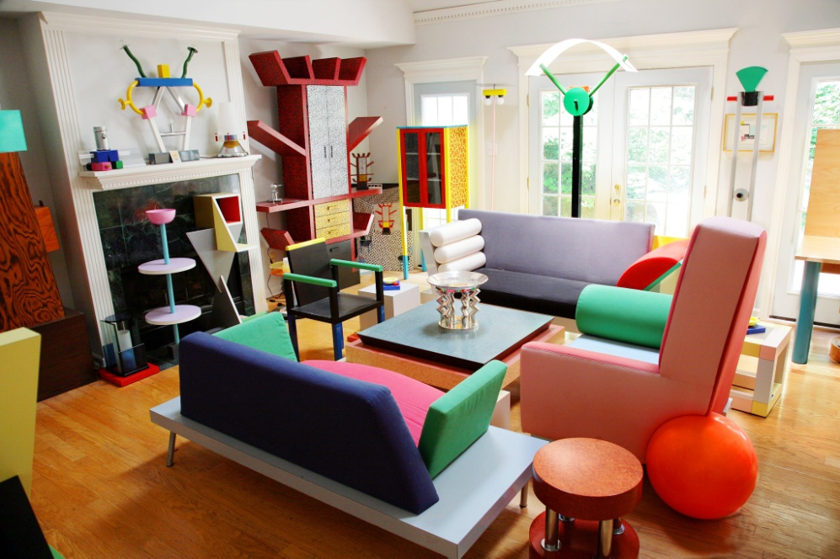
Interior design is a design branch aimed at interior of premises in order to provide convenience and aesthetically pleasing interaction of the environment with people

Slide 3
Why did I choose this profession?
It is connected with creativity
Profession in demand
I have many ideas that I wont to put into practice
It allows you to create a world around you
I like this profession

Slide 4
What does an interior designer do?
The creation of interior design projects
Analysis of the client's wishes
Development of drawings, sketches, diagrams for discussion with the client
Measurement of premises and development of future design.
Create layout and 3-D modeling.
The choice of materials, the General color scale (according to wishes of the client), furniture, home furnishings
Budget development and accurate calculation of the cost of the interior.
Preparation of work plans and schedules for workers.
Time management

Slide 5
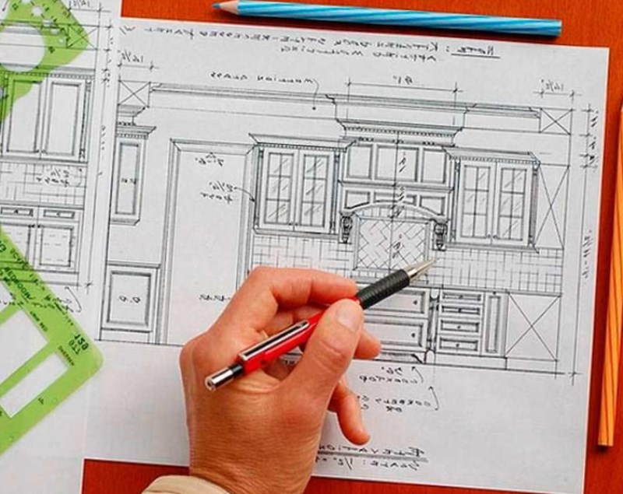

Slide 6
The pros and cons
Pros
Wide scope of application of acquired skills.
Quite good earnings.
Constant communication with new people, useful contacts.
Free schedule.
The prestige of the profession.
The joy of successful projects.
The independence of the chief.
You can work on a pension.
Creative work

Slide 7
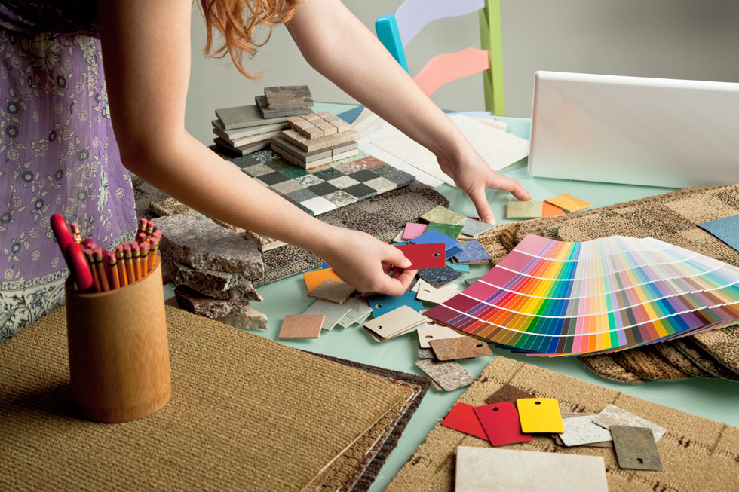
Cons
The absence of such opportunities, as vertical growth.
Not to dispense with the accumulated range of reliable partners.
Work will not always be permanent.
Your views will not always coincide with the views of customers but the client is always right.
If you have started the project, then nothing should interfere with you(illness, personal affairs)
A sharp start after training is rare

Slide 8
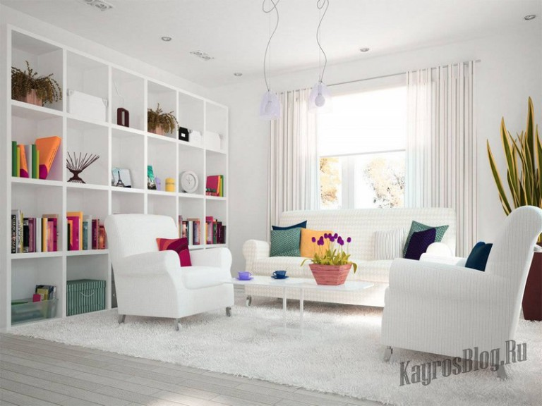
Professional qualities
1. The taste and creativity, his own creative mind.
2. Patience and hard work.
3. Ability to listen and hear the client.
4. The ability to present your entire project at an early stage.
5. Sufficient IT skills (an advanced user).
6. Knowledge and understanding of the basics of space ergonomics, architecture, painting, design, color combination, construction
7. Knowledge of the basic interior styles, as well as the principles of implementation of these styles in the interior with all the nuances.

Slide 9
Styles

Slide 10
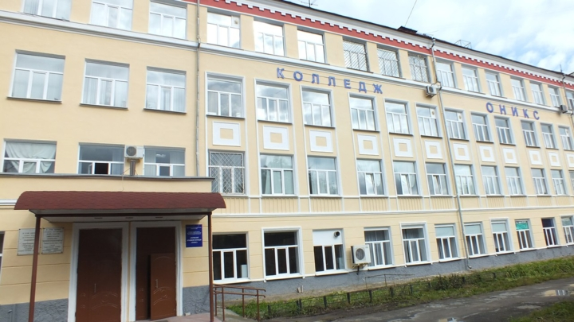
Where to study?
The Perm regional College "Onyx»
Perm College of professional technologies and design

Slide 11
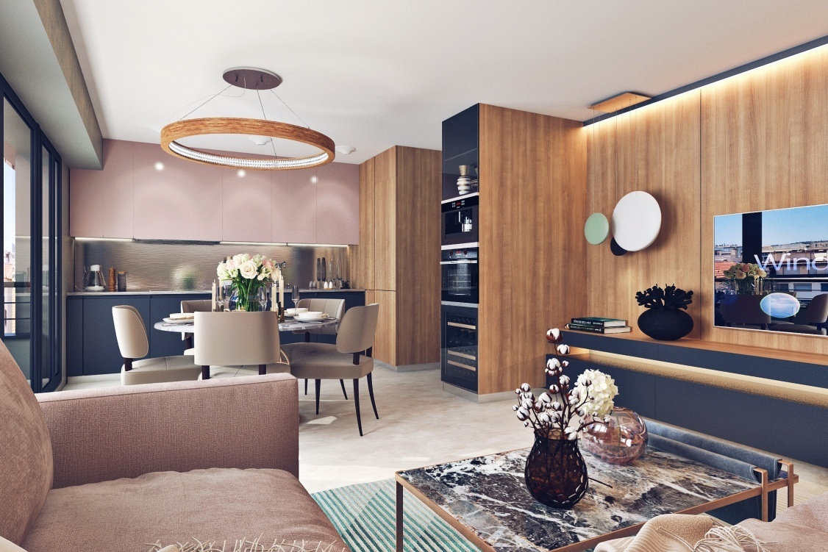
WHAT DO I DO TO GET THIS PROFESSION ?
I’m going to dram
I try to design something already
preparing for entrance exams

Slide 12
Thank you for attention

